Slide 1
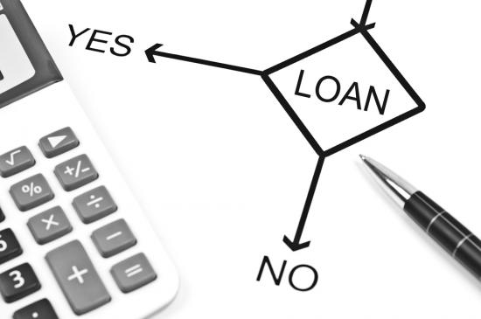
Analysis of Lending Club's issued loans
Team 2
Hang Ding, Fangling Zhang, Qingquan Zhao, Yihao Zhou, Tongge Zhu

Slide 2
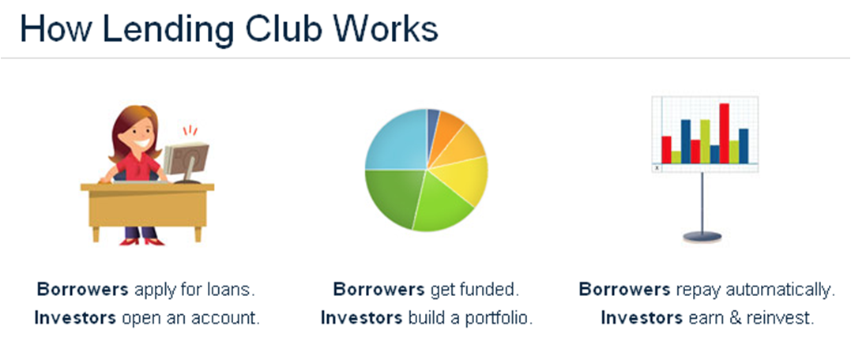
Background

Slide 3
Motivations:
Detect and predict bad debt
Distinguish the risk level of different kinds of loans
Decrease default rate of loan
Make business decisions
Improve loan issue time cycle
Increase benefit!

Slide 4
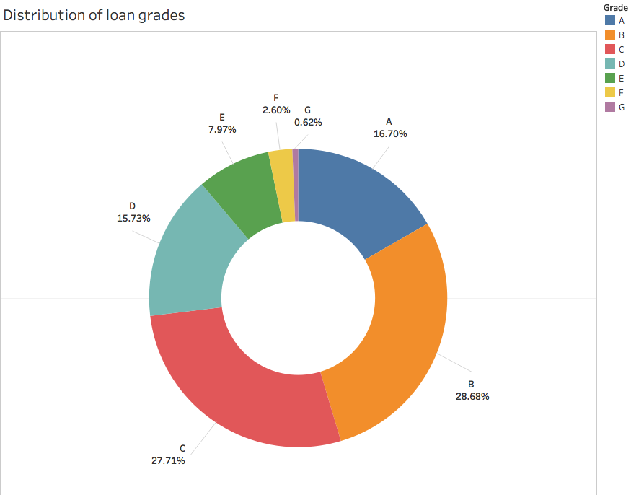
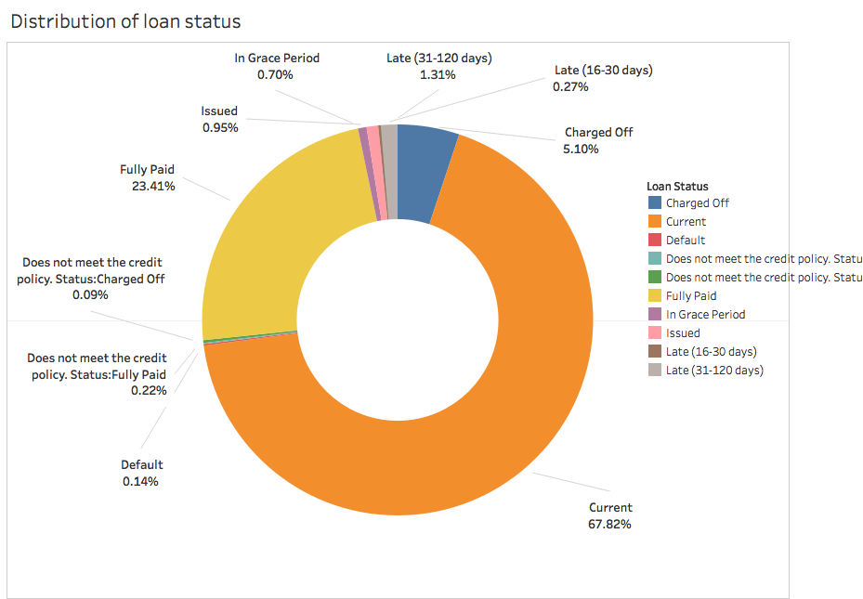
Data Distribution:
loan grade & loan status

Slide 5
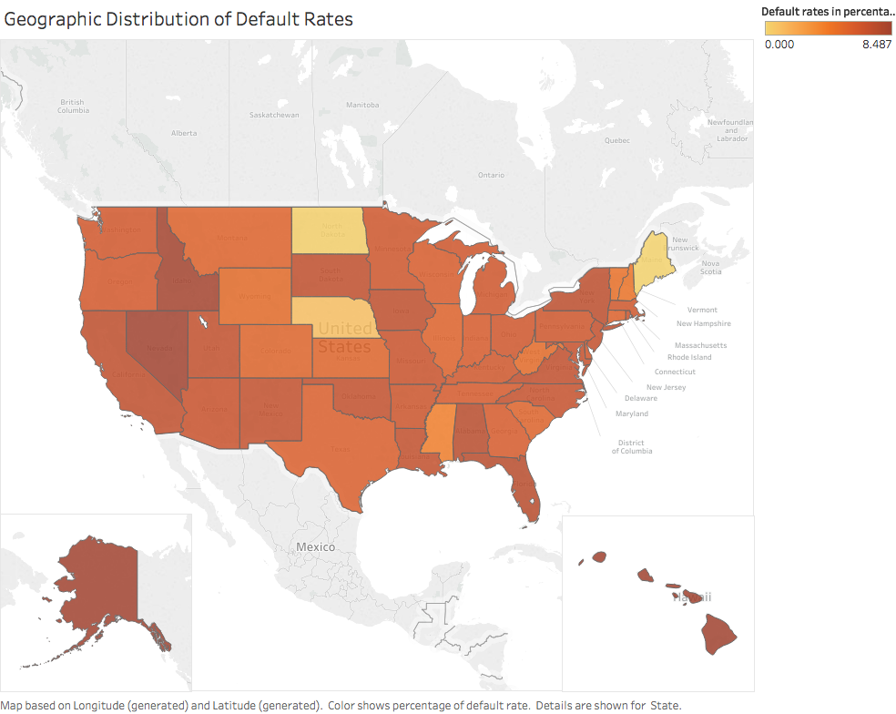
Data Distribution:
Default rate

Slide 6
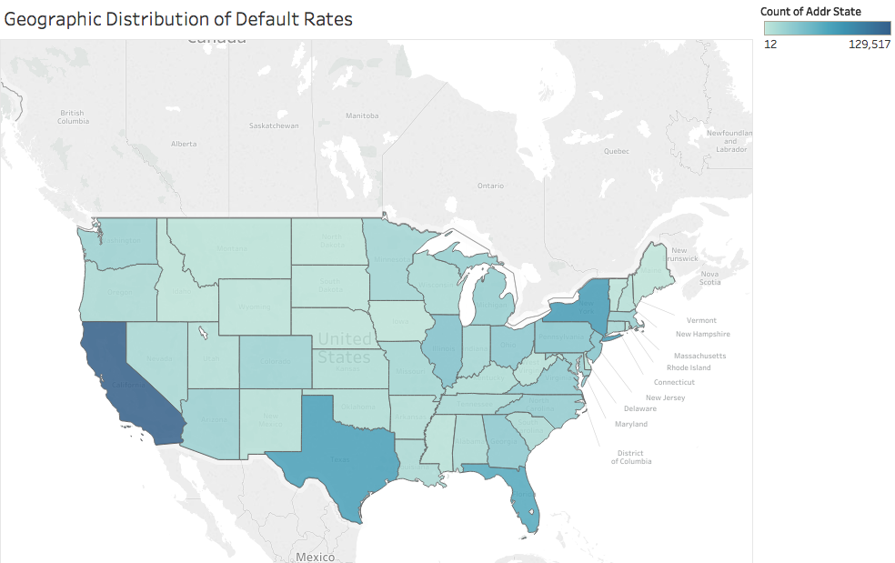
Data Distribution:
Number of loans

Slide 7
Analysis Workflow:
Preprocessing Data
Data Cleaning
Feature Selection
Encoding Categorical Features
Model Selection
Decision Tree
RandomForest
Logistic Regression
Others
Machine Learning
Mathematical Rationalization

Slide 8
Class Definitions
Good Customers (class A):
Whoever behave good in load
Default Customers includes (class B):
Late (31-120 days)
Charged Off
Default

Slide 9
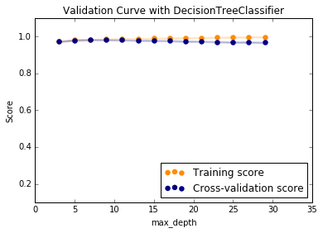
Decision Tree Classifier
- Cross Validation Curve

Slide 10
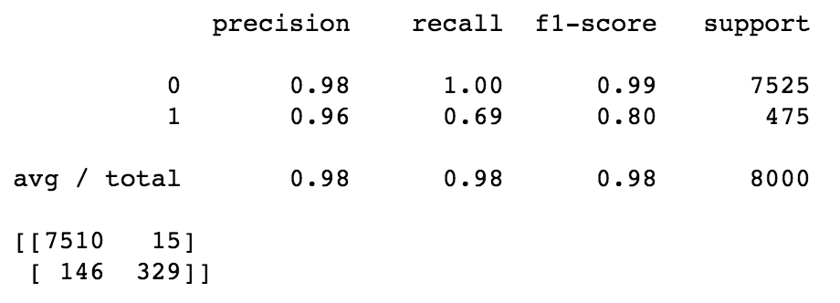
Decision Tree Classifier
- Result

Slide 11
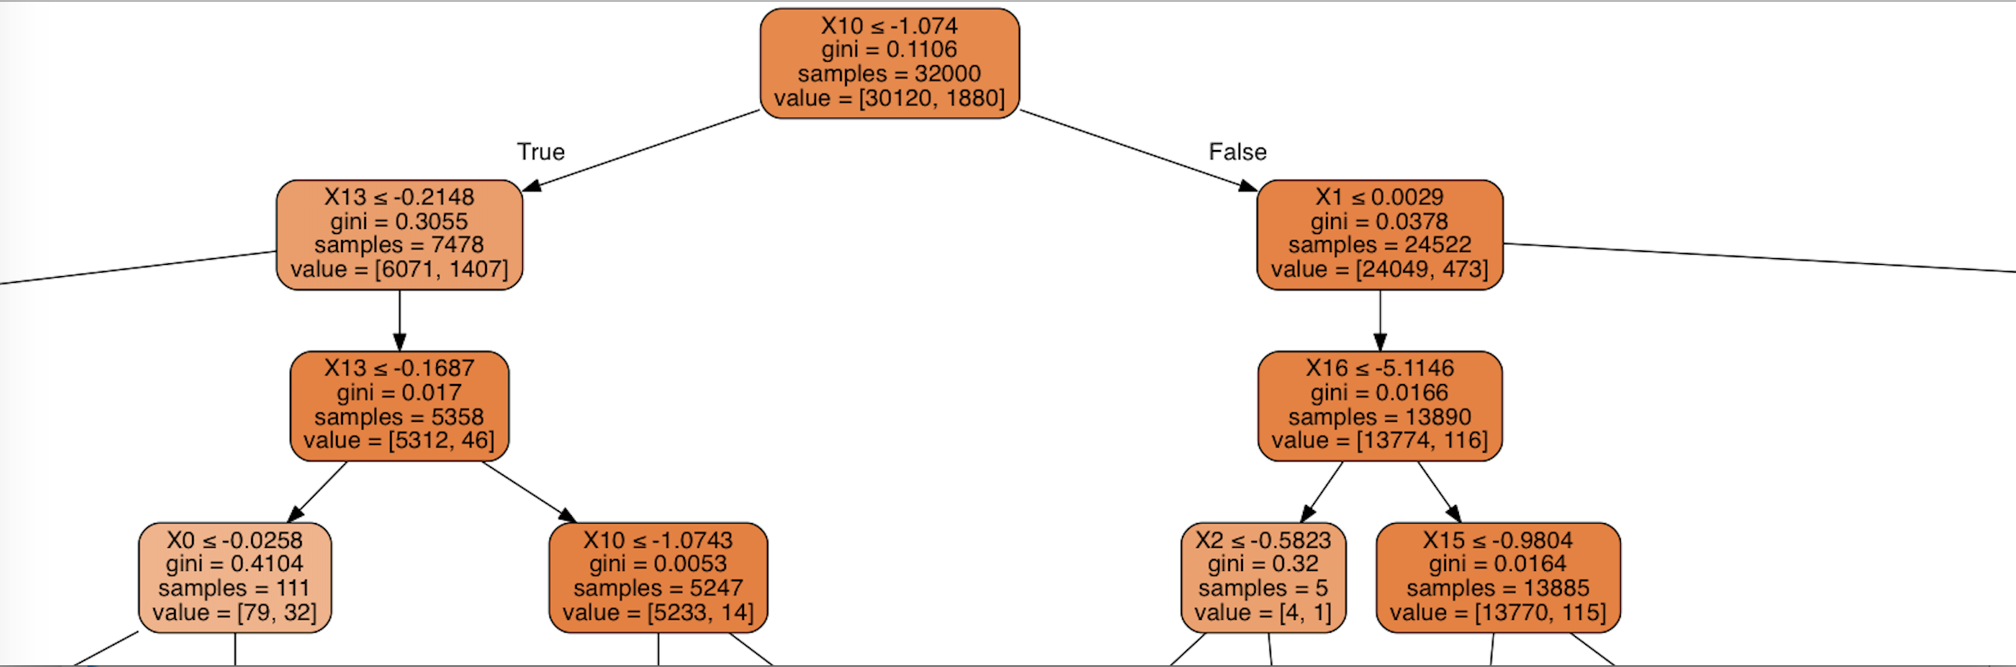
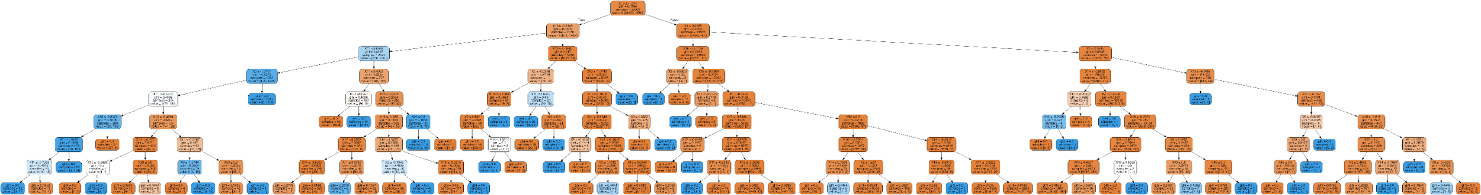
Decision Tree Classifier
- Mathematical Rationalization

Slide 12
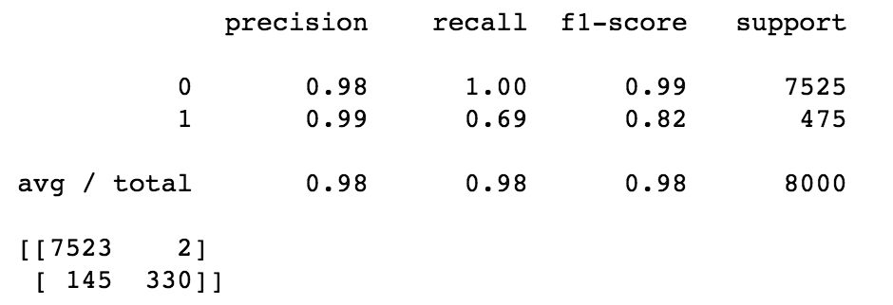
Random Forest Classifier
- Result

Slide 13
Imbalanced Data
Balanced Data
Class A: 37637
Class B: 2363

Slide 14
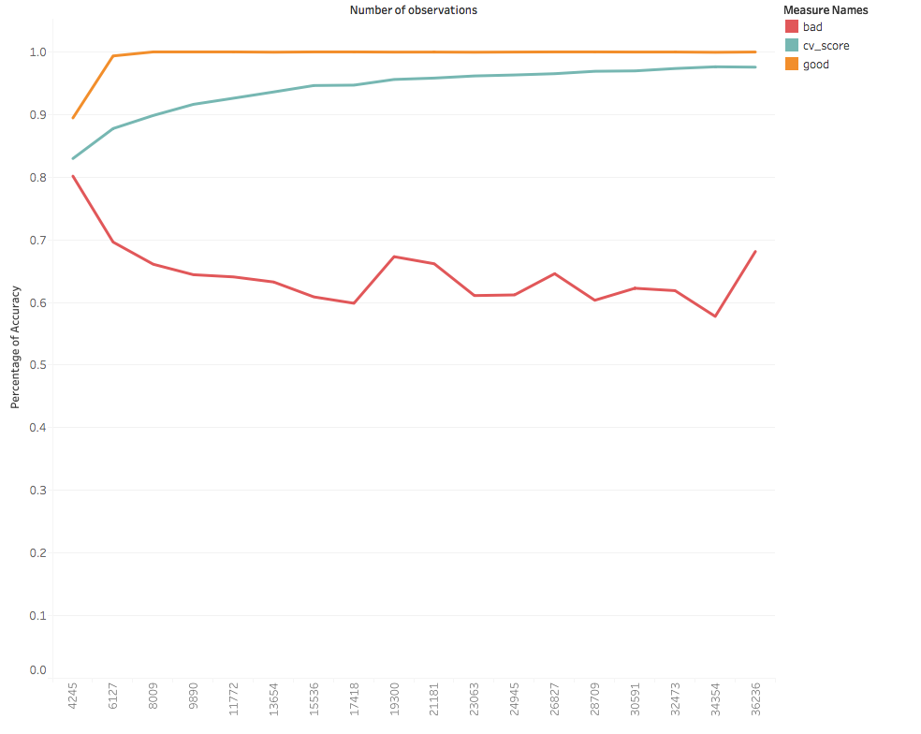
Which ratio is best?
Class A: 3764
Class B: 2363

Slide 15
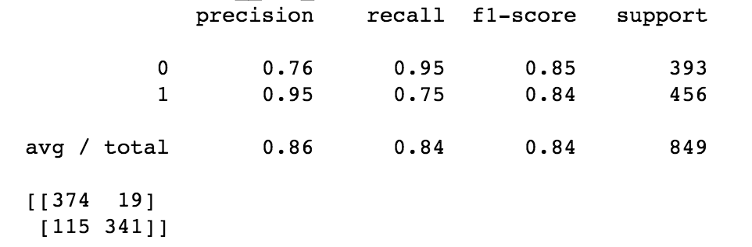
Decision Tree Classifier
with Balanced data
- Result

Slide 16
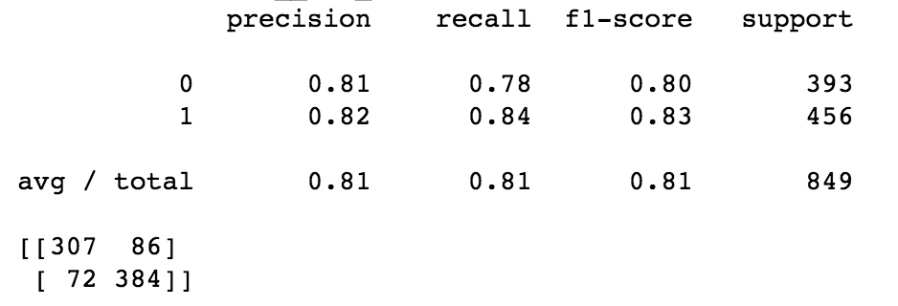
Random Forest Classifier
with Balanced data
- Result

Slide 17
Comparison of prediction result between the models
- Key Point = Sensitivity * 0.2 + Specificity * 0.8
 | Sensitivity | Specificity | Key Point | Selection
Decision Tree | 0.69 | 1 | 0.75 | X
Random Forest | 0.69 | 1 | 0.75 | X
Decision Tree with balanced data | 0.75 | 0.95 | 0.79 | X
Random Forest with balanced data | 0.84 | 0.78 | 0.83 | ✔
Logistics Regression | 0.75 | 0.99 | 0.8 | X
SVM | 0.66 | 1 | 0.73 | X
K-NN | 0.54 | 0.92 | 0.62 | X
ExtraTrees | 0.63 | 0.97 | 0.7 | X
Gradient Boosting | 0.75 | 0.99 | 0.8 | X
MLP | 0.7 | 0.98 | 0.76 | X

Slide 18
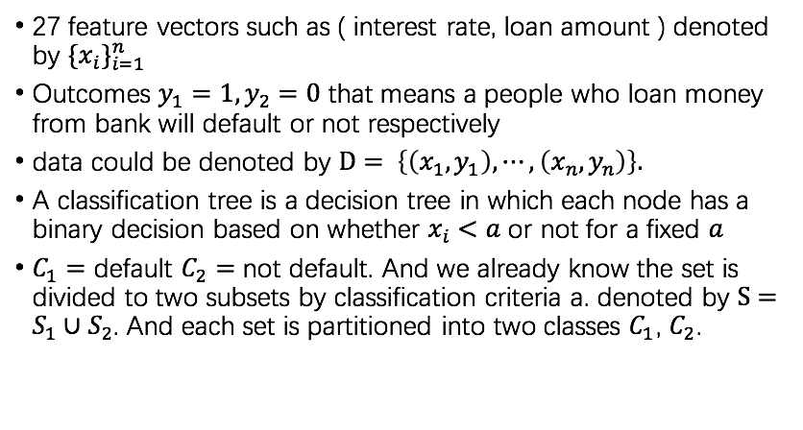
Mathematical Rationalization
Decision Tree Classifier

Slide 19
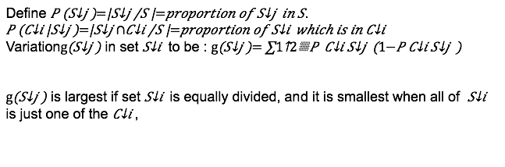
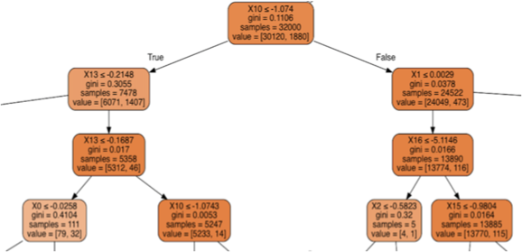
Mathematical Rationalization
Decision Tree Classifier

Slide 20
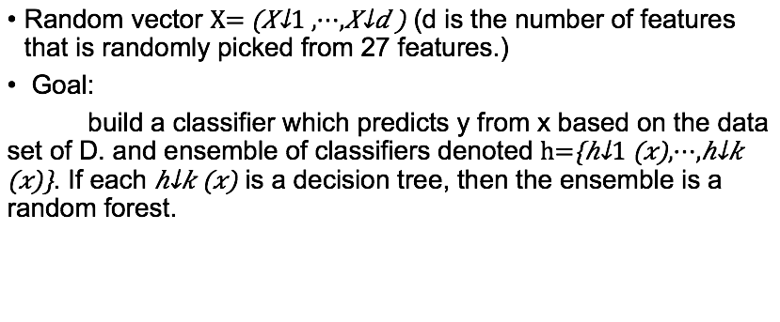
Mathematical Rationalization
Random Forest Classifier

Slide 21
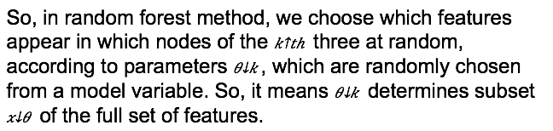

Mathematical Rationalization
Random Forest Classifier

Slide 22
Thanks for your attentions!

